Slide 1
Drug Review
Natural language processing (NLP)

Slide 2
TABLE OF CONTENTS
01
02
03
07
Introduction
Design
Exploration and Pre-processing
K- Means & Hierarchical
04
05
Topic modeling
06
Classification models
08
tools
09
conclusion
Recommendation system

Slide 3
01 Introduction

Slide 4
Introduction
This project about analyzing reviews made by various patients for specific drugs on different pharmaceutical review sites to predict sentiments for drugs.
Business problem
help the drug manufacturers understand the sentiments behind thousands of reviews from patients in more efficient and quicker way that can help them in making decisions to improve their drugs.

Slide 5
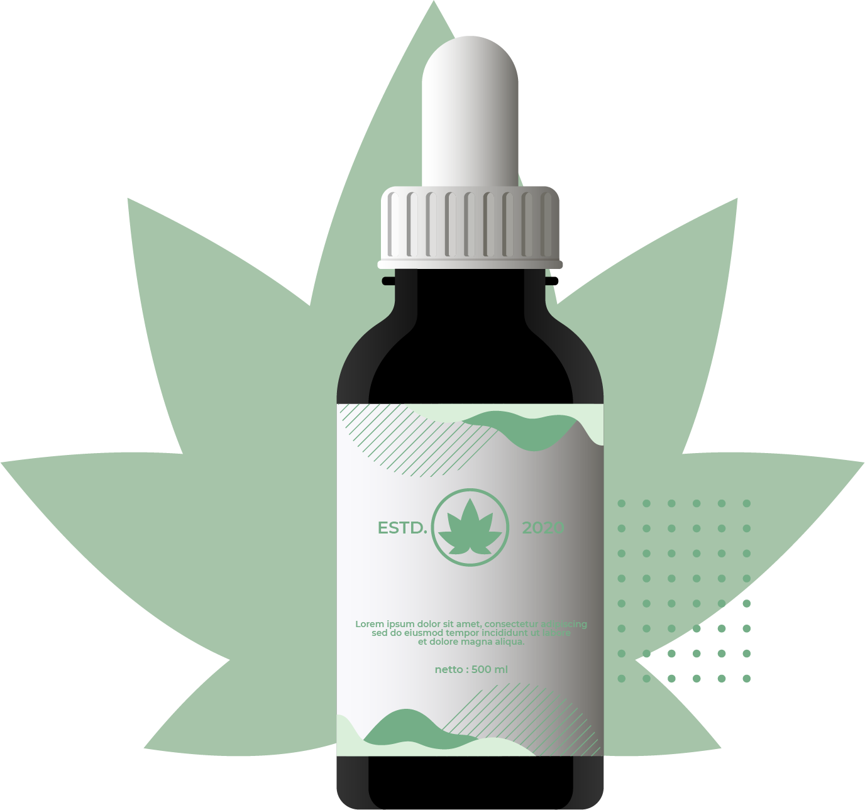
02 Design

Slide 6
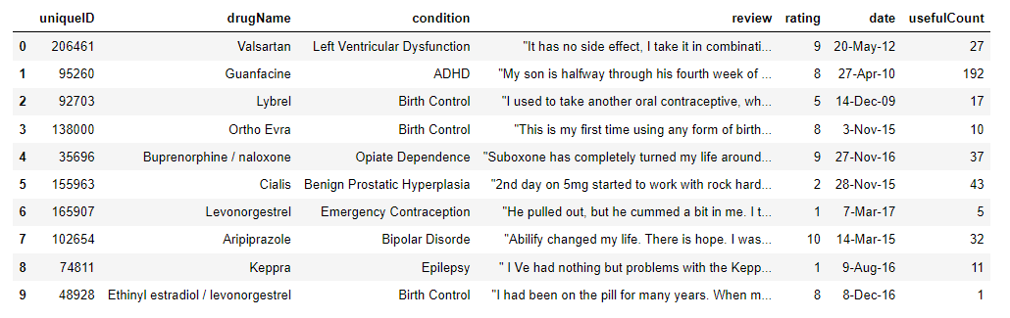
Dataset
Dataset source:
Size of Data:
From Kaggle websit
Number of rows: 161297 Number of columns: 7

Slide 7
03 Exploration and Pre-processing

Slide 8
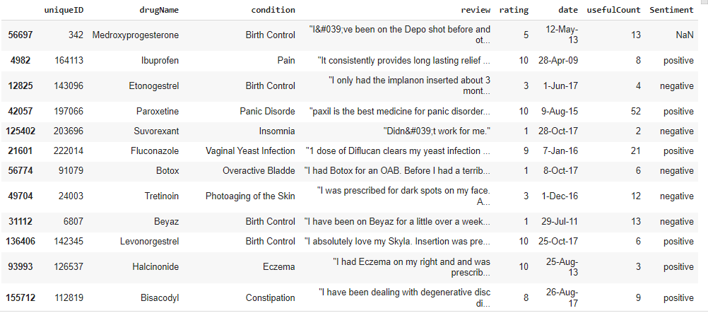
Sentiment column
Classify drug ratings into two classes positive and negative based on the patient ratings.

Slide 9
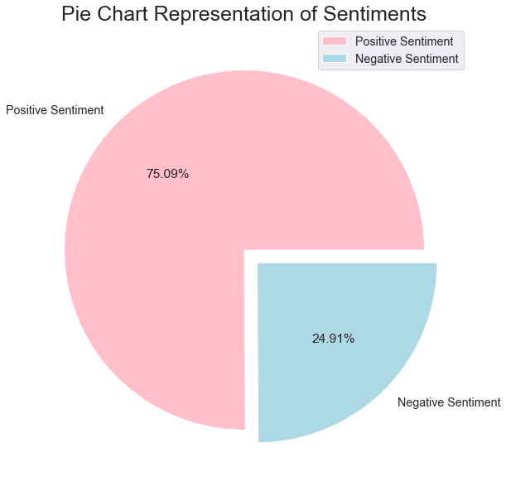

Slide 10
NLP Pre-Processing
1
2
3
4
Converting to lower case
Lemmatization
Vectorization
Removing punctuation, digits, stop-words, special characters

Slide 11
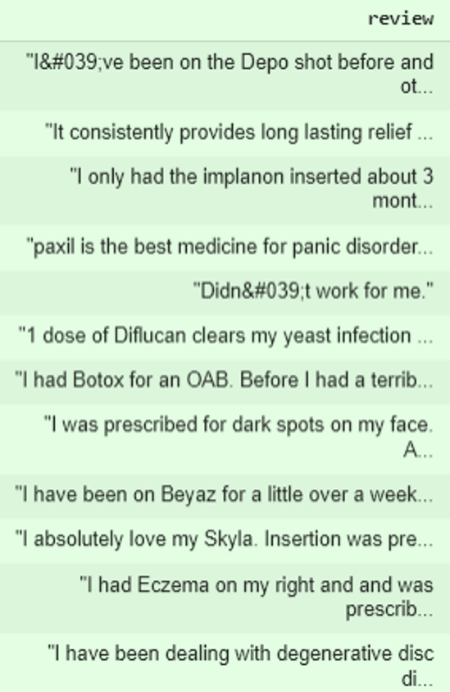
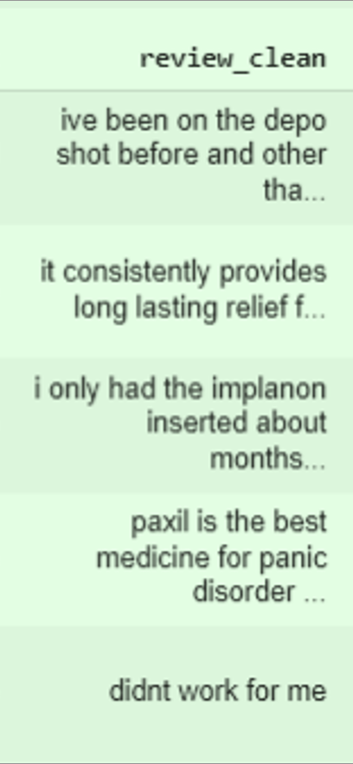
Text clean

Slide 13
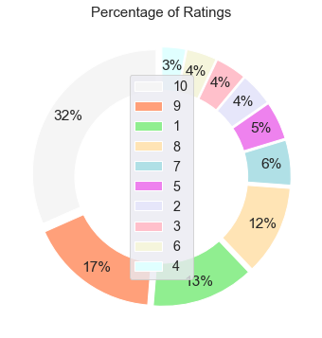

Slide 14
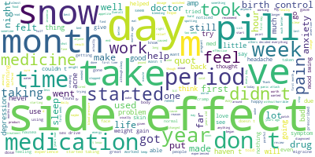
word cloud

Slide 18
04
K- Means & Hierarchical

Slide 19
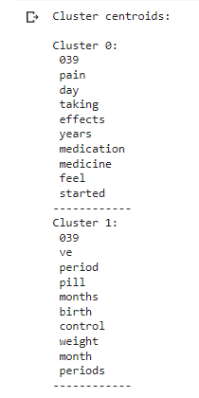
K- Means clustering TF-IDF

Slide 20
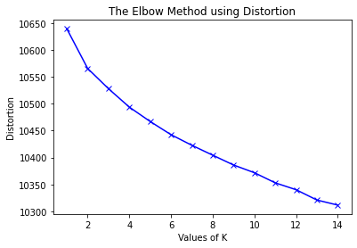
K- Means clustering TF-IDF

Slide 21
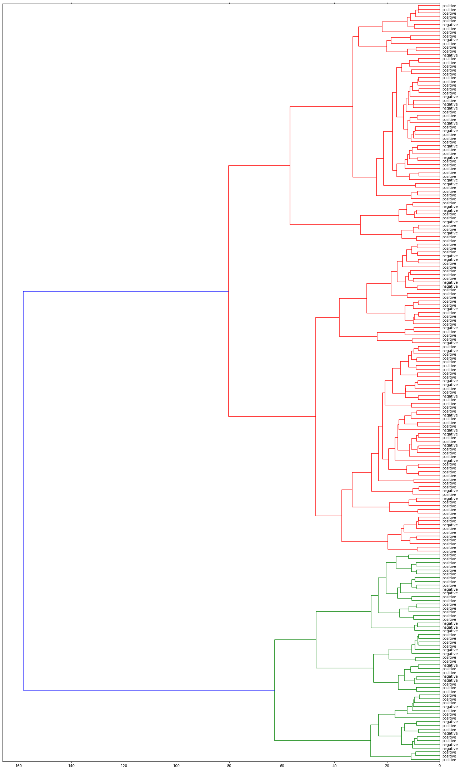
Hierarchical

Slide 22
05
Topic modeling

Slide 23
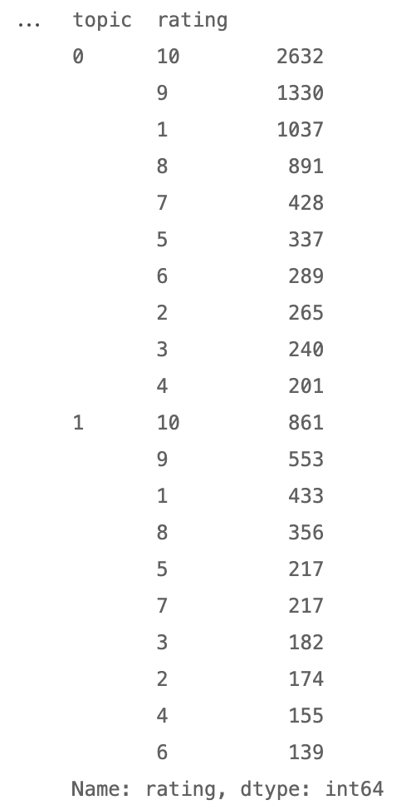
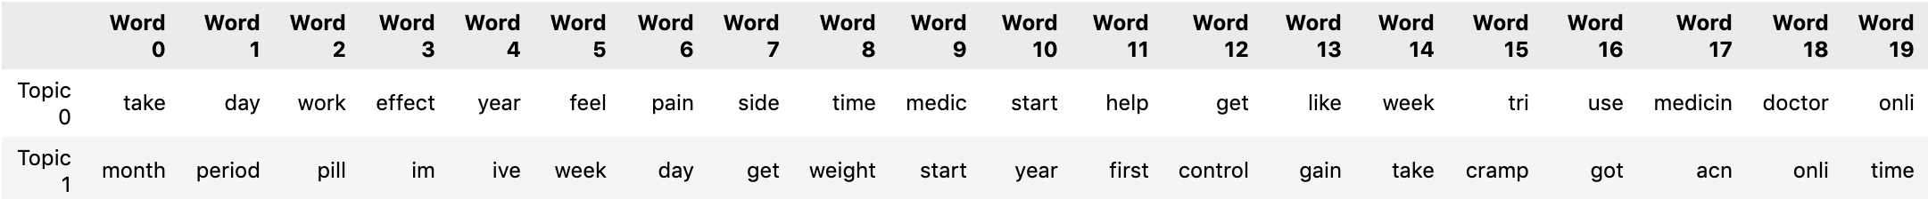
LDA (Latent Dirichlet Allocation)

Slide 24

06
Classification models

Slide 25
Classification models
 | accuracy
Model | Counter vectorization | TF-IDF
Logistic Regression | 0.83 | 0.80
Naive bayes | 0.80 | 0.80
decision tree | 0.72 | 0.75

Slide 26
07
Recommendation System

Slide 27
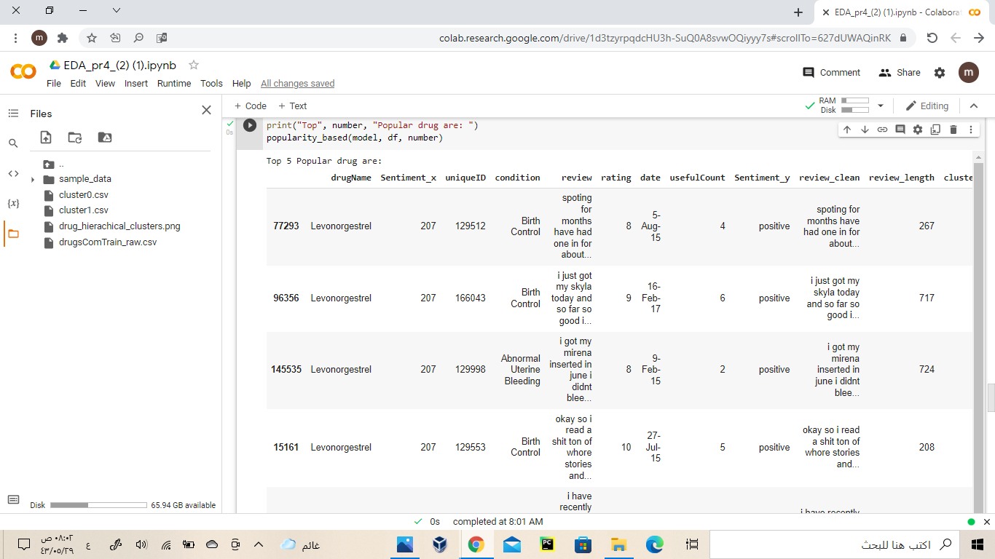
Recommendation System

Slide 28




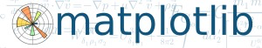






08 TOOLS
Python
Github
Power Point
Zoom

Slide 29
09
conclusion

Slide 30
conclusion
Reviews are becoming an integral part of our
daily lives.
The best model Logistic Regression
accuracy 0.83
Future work : Using different values of n-grams and optimization of algorithms to improve the performance.

Slide 31
OUR TEAM
01
02
03
04
05
Shaima
Nasser
Munira
Eman
Raghad

Slide 32
THANKS!
Do you have any questions?

